Slide 1
E-COMMERCE FUNCTIONALITY OVERVIEW
Presentation by Your Name

Slide 2
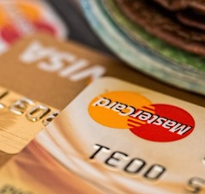
Wishlist Features
Key Wishlist Functions
The Wishlist lets users save products for later purchase, enhancing their shopping experience.

Slide 3


Cart Actions
Completing Purchases
Users can buy all items in their Cart at once, simplifying checkout and reducing cart abandonment.
Managing Your Cart
Users can add items to their Cart for later purchase and remove unwanted items.

Slide 4
Sorting Options
This table summarizes the available sorting options that enhance product search and navigation.
SORTING CRITERIA | DESCRIPTION | IMPORTANCE
Category | Sort items by product category | Helps users find specific items faster
Price | Sort items based on price range | Assists users in finding products within budget
Name | Alphabetical sorting of product names | Makes product identification easier
Min | Minimum price filter for products | Ensures all displayed products meet budget constraints
Max | Maximum price filter for products | Helps target higher-end products
Is Available | Shows only in-stock items | Improves user experience by avoiding out-of-stock products

Slide 5

Purchase History Insights
Accessing Purchases
Users can access purchase history easily for returns and customer inquiries. Insights can guide future purchases.

Slide 6

Product Recommendations
Use of Algorithms
Encouraging Sales
Algorithms analyze data to enhance product relevance and satisfaction.
Effective recommendations boost sales as users tend to buy suggested items.
Based on Purchase History
Recommendations stem from past purchases, tailoring suggestions to user preferences.

